Slide 1
Accessing Data through Web Services

Slide 2
IRIS Services – service.iris.edu
FDSN Web services
dataselect
station
event
Documentation
IRIS web services
timeseries
rotation
sacpz
resp
evalresp
virtualnetwork
traveltime
Flinnengdahl
distaz
products

Slide 3
IRIS Services – easy to use through a variety of tools
IRIS and FDSN Services
Extensive documentation
Builders exist to help understand URL patterns
Key Links
Overall IRIS Services
Documentation
URL Builders

Slide 4
Programmatic support is widespread
Modern computer languages that include support for basic web services include:
Java
Perl
Python
PHP
MatLab
JavaScript
R (e.g. Rcurl)
C#
C/C++ (multiple libraries)

Slide 5
Perl Fetch scripts: command line access
http://service.iris.edu/clients/
FetchData
FetchEvent
FetchMetadata

Slide 6
FetchData options
FetchData retrieves miniSEED, simple metadata, SEED RESP
and/or SAC Poles and Zeros using the following selection criteria:
Network, Station, Location and Channel
all optional, can contain ‘*’ and ‘?’ wildcards, virtual networks supported
Start and end time range
Geographic box or circular region
Selections: command line, selection list file or BREQ_FAST file

Slide 7
FetchData example
Request 1 hour of GSN/ANMO long-period vertical (LHZ) data and simple metadata for 2010-2-27 M8.8 Chilean earthquake:
$ FetchData
-N IU –S ‘ANMO’ –L 00 –C ‘LHZ'
-s 2010-02-27,06:34:00 -e 2010-02-27,07:34:00
-o /data/Chile-GSN-LHZ.mseed
-m /data/Chile-GSN-LHZ.metadata
Convert the miniSEED to SAC with metadata
$ mseed2sac Chile-GSN-LHZ.mseed –m Chile-GSN-LHZ.metadata
-E '2010,058,06:34:11/-36.122/-72.898/22.9'

Slide 8
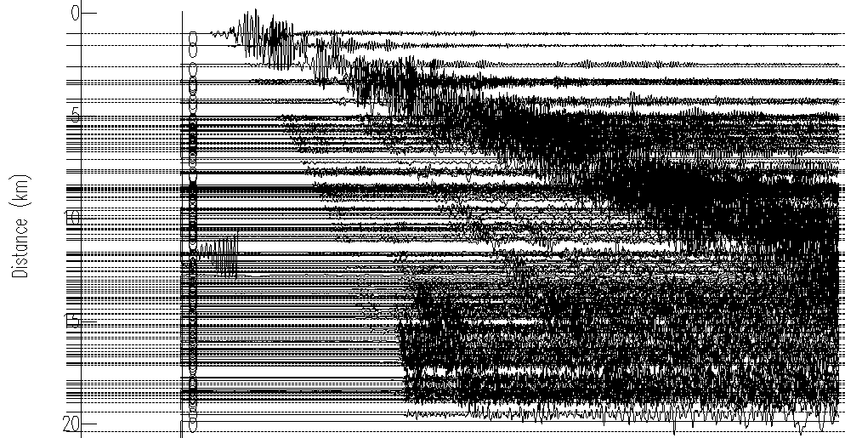
FetchData example results
2 minutes later…
121 SAC files and a quick-n-dirty record section:

Slide 9
Performance
WS-dataselect has been shown to be able to deliver 5 terabytes of data per day to a single remote user

Slide 10
FetchEvent options
FetchEvent retrieves event information from ws-event and prints simple ASCII output. Events can be selected using these criteria:
Start and end time range
Geographic box or circular region
Depth range
Magnitude range and type
Catalog and contributor
IRIS event ID
Other options:
Include secondary origins (default is primary only)
Order results by magnitude or time
Limit to origins updated after a specific date

Slide 11
FetchEvent example
Request events for a 20 minute period including secondary origins:
$ FetchEvent -s 2010-2-27,6:30 -e 2010-2-27,6:50 -secondary

Slide 12
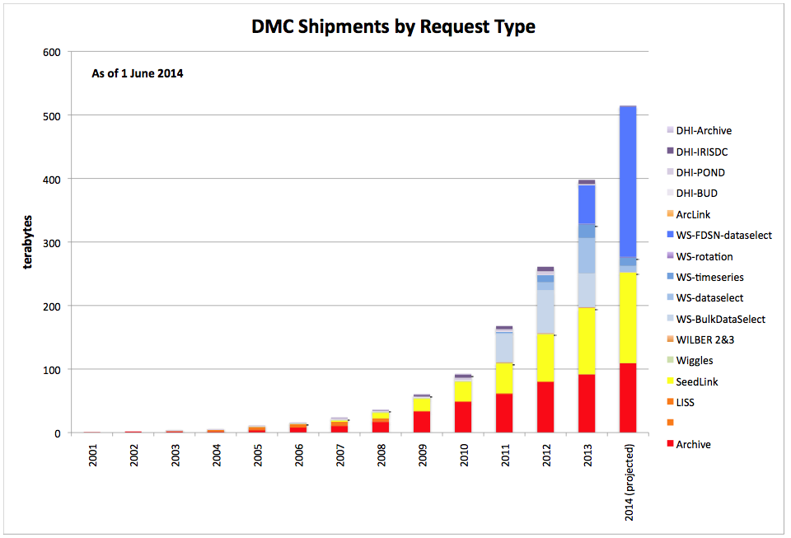
The success of web services

Slide 13
International Coordination
FDSN web services are well coordinated between Europe and the US
Intend to promote them elsewhere
Canada, Japan, China, SE Asia
Many developers producing ws aware clients
ObsPy
SOD
jWeed
WILBER 3

Slide 14
Vertical Integration of Seismological Data Centers
FDSN federated web services
dataselect – for time series observations
station – for metadata describing the recording station
event – info related to earthquakes and events
Fully adopted by the FDSN working groups
Description of the payload (XML, text, etc)
Calling convention ( parameter specifications)

Slide 15
Participants in Federation
Europe
France – RESIF
Germany – GFZ
Italy – INGV
Netherlands – ORFEUS Data Center
Switzerland – ETH
US
IRIS DMC
NCEDC

Slide 16
Standardization of web services
Root URL: unique for each data center
IRIS http://service.iris.edu/fdsnws/station/1/
ORFEUS http://www.orfeus-eu.org/fdsnws/station/1/
NCEDC http://ncedc.org/fdsnws/station/1/
RESIF http://ws.resif.fr/fdsnws/station/1/
GEOFON http://geofon-open2.gfz-potsdam.de/fdsnws/station/1/
INGV http://webservices.rm.ingv.it/fdsnws/station/1/
query?net=IU&sta=ANMO&loc=00&cha=BHZ&starttime=2010-02-27T06:30:00&endtime=2010-02-27T10:30:00&nodata=404
Query Parameters: standardized

Slide 17
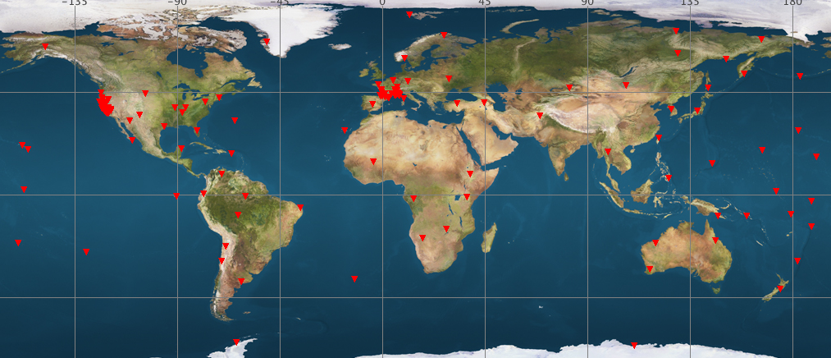
Accessing Information from NCEDC (BK), RESIF (FR), and IRIS (IU)

Slide 18
IRIS Federator
IRIS is developing a federating web service that will allow a user to make a request to a web service at IRIS. This service will return a set of URLs that will allow the software running on a user’s computer to directly access the appropriate data center to service their request
IRIS
Federator
USER

